Slide 1
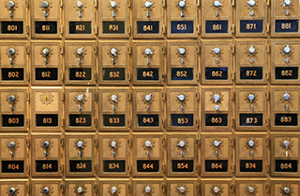
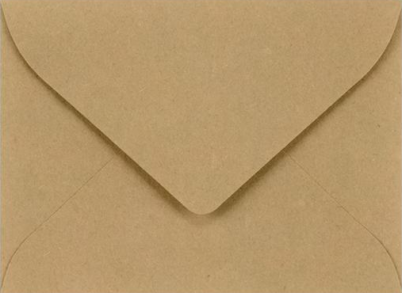
Associative Arrays Like normal arrays but so much cooler!
What’s in box 372?
Power
Bill
Where’s the power bill?
In box 372

Slide 2
Associative Arrays (Key Value Pairs)
Interface to data structure:
void insert(KeyType key, ValType val);
void delete(KeyType key);
ValType &get(KeyType key);
Some method to iterate over all keys/vals
What properties must KeyType have?
Could be implementation dependent

Slide 3
Associative Arrays (Use Cases)
I think content addressable memory is an awesome thing
Let’s come up with some ideas when this would be a useful data structure.

Slide 4
Designing Associative Arrays
In class exercise (Divide into groups of 4 or 5)
Design with std::list
Show what the header will look like
Make it a template
Show pseudocode. Flow charts, diagrams, etc
Present your ideas to the class
Complexity analysis (Big O and Big Theta)

